Slide 1
Gesture controlled robot using Raspberry Pi

Slide 2
Step 1: Load raspbian os on a micro sd card and insert into raspberry pi3 model B+.
https://www.youtube.com/watch?v=B5wkXu6tmb4

Slide 3
Step 2: Open Laptop’s Network sharing centre and share nework connection.
https://www.youtube.com/watch?v=AJ7skYS5bjI&t=219s

Slide 4
Step 3: Make sure SSH server is enabled otherwise enable it manually.

Slide 5
Step 4: Power on raspberry pi and connect a LAN cable with Laptop and pi. Step 5: Open Advance Ip scanner and copy the detected Ip address for raspberry pi. Step 6: Open MobaXterm and pest detected Ip address.

Slide 6
Step 7: Default user name is = pi Default password is = raspberry

Slide 7
Step8: Update and upgrade your raspberry pi >>sudo apt-get update >>sudo apt-get upgrade

Slide 8
step9:
Install VNC server on raspberry pi, laptop and Phone for remote server control.
>>sudo apt-get install tightvncserver
and activate it.
>> tightvncserver
Step10:
>> sudo raspi-configOpen Networking option and enable wifi and connect it via phone.

Slide 9
Step11: >>ifconfig Copy your wlan0 ip address >>netstat –nr Copy your static router ip address >>sudo nano /etc/dhcpcd.conf On the nano editor

Slide 10
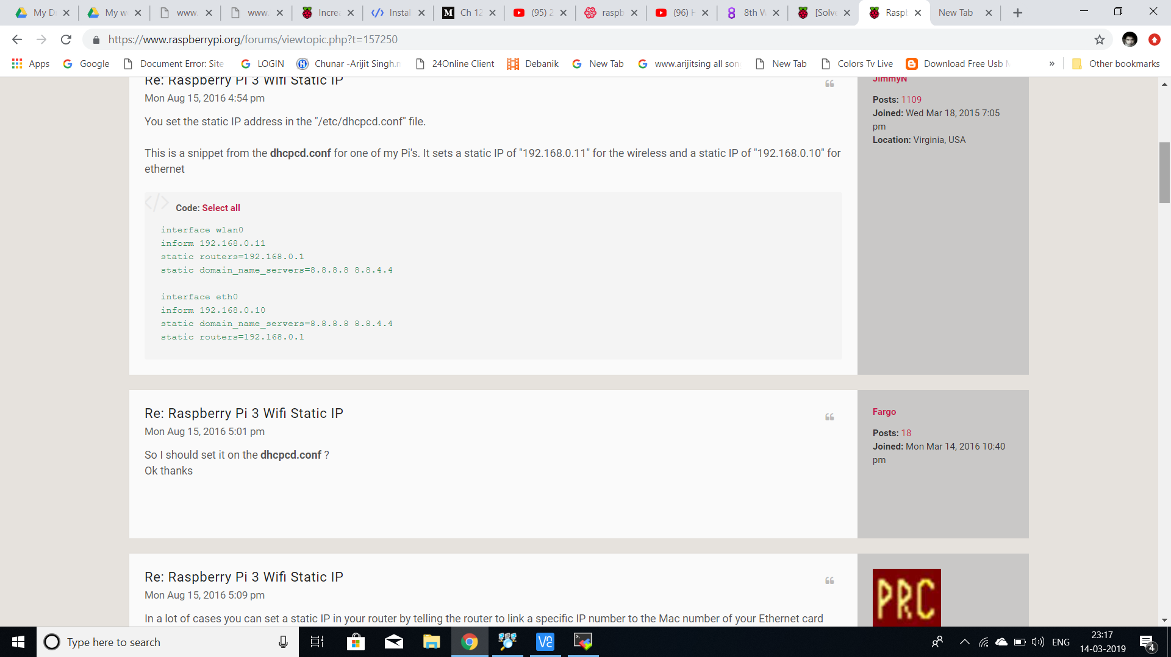

Slide 11
Step12: Disconnect your LAN connection and see Raspberry pi is now connected via your phone. Laptop has connected via same network and now open MobaXterm and type static ip and it’s boom!!! Working working working .

Slide 12
Step13: Install open cv
https://www.alatortsev.com/2018/11/21/installing-opencv-4-0-on-raspberry-pi-3-b/

Slide 13
Step14:
>> sudo raspi-config
Open interfacing divice and enable pi camera
Step15:
Make HARDWARE MODEL and connect it with Raspberry pi via GPIO poart
For me
GPIO11-pin23 -> en1 (H-bridge)
GPIO9-pin21 -> in1 (H-bridge)
GPIO10-pin19 -> in2 (H-bridge)
GPIO23-pin16 -> en2 (H-bridge)
GPIO24-pin18 -> in3 (H-bridge)
GPIO25-pin22 -> in4 (H-bridge)

Slide 14
Step16: Programming:
https://drive.google.com/open?id=1Sh5yVkCqfjHLWJhdc5WSZIGe599BEuJc

Slide 15
THANK YOU

